Slide 1
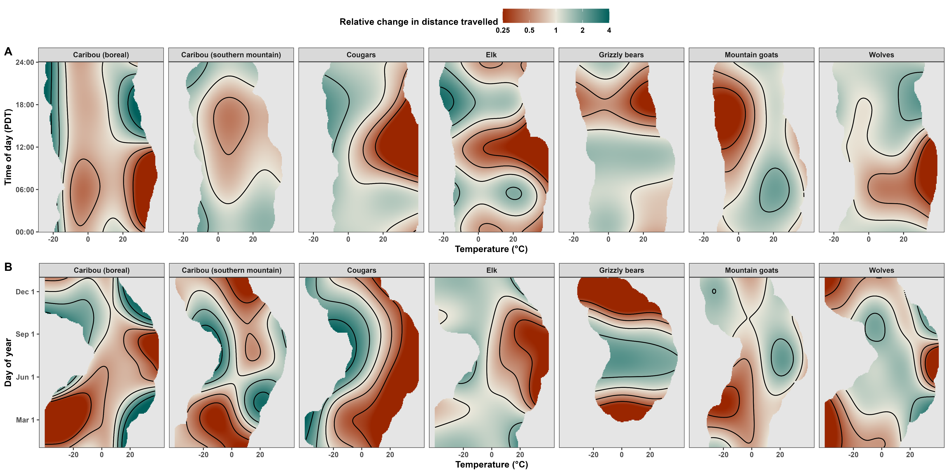
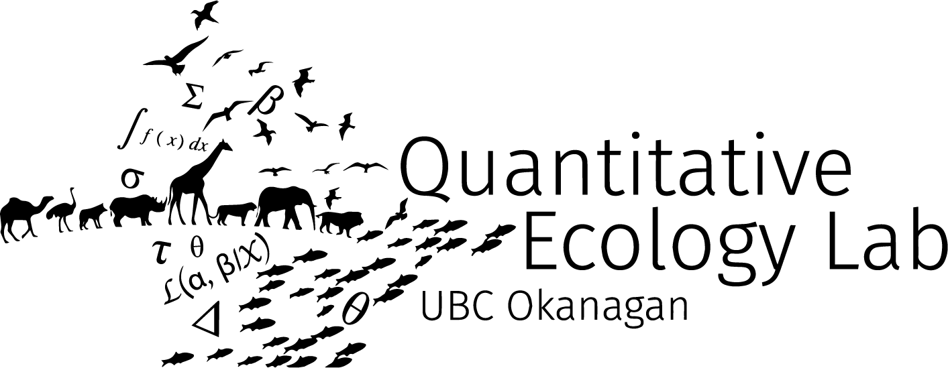

The heat is on: Rising temperatures alter when, how, and where large terrestrial mammals move
Stefano Mezzini
Ph.D. Biology candidate

Slide 2
A bit of history…

Slide 3
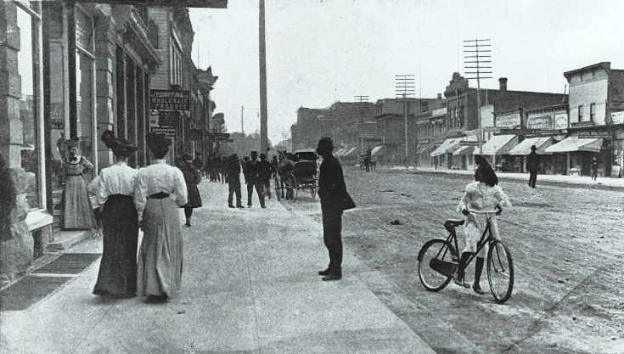
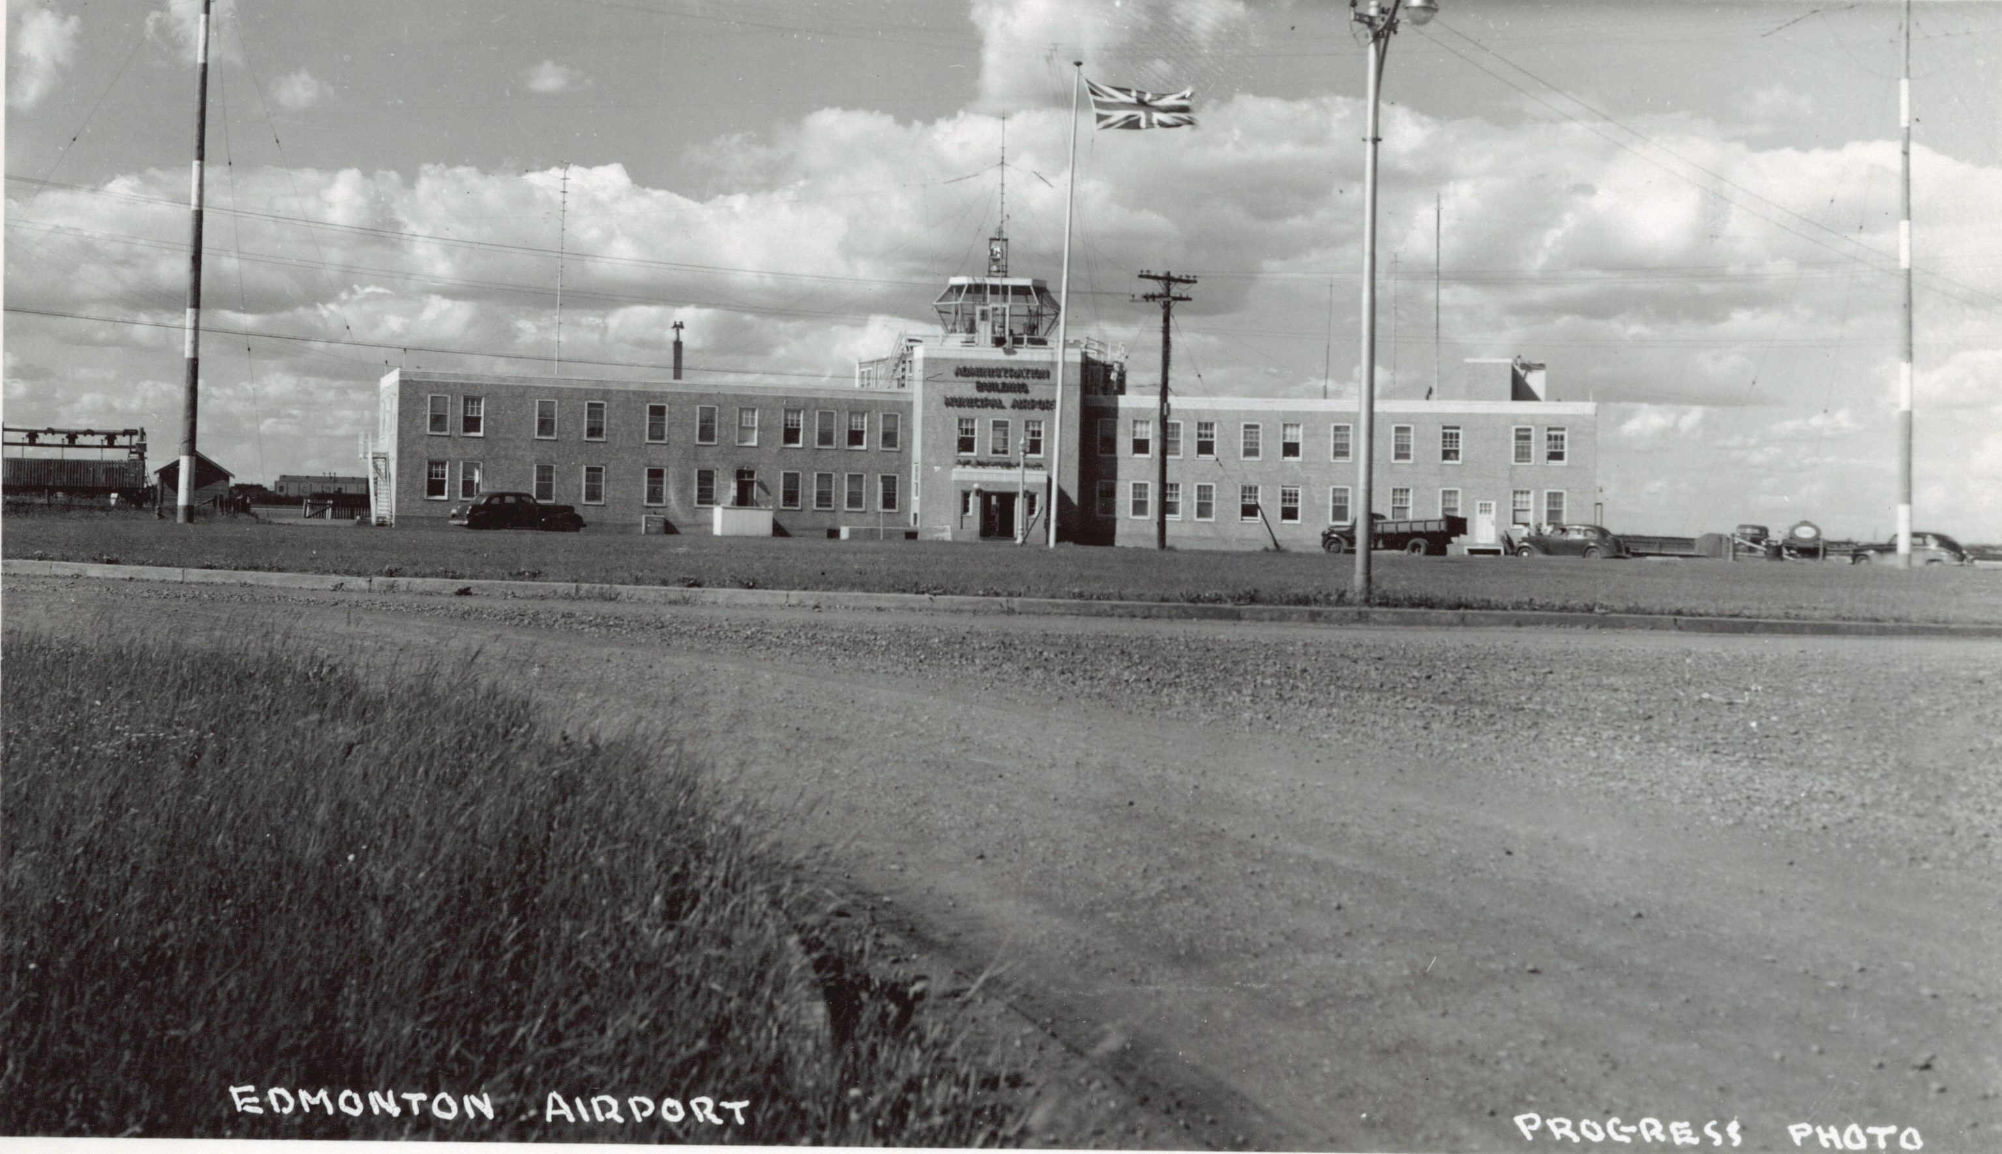
Edmonton has changed since 1925
1905: Alberta becomes a Canadian Province
1910s: Population boom
1916: Population crashed by 19 000 (26%)¹
1929: City Centre Airport opens
Jasper Ave circa 1910
https://archive.org/details/PC012149

Slide 4

The Land before Edmonton: Amiskwaciy Wâskahikan
Canada was founded on colonial beliefs and actions
Other Peoples lived with these Lands for millennia:
ᓀᐦᐃᔭᐊᐧᐠ Nehiyawak (Cree),
Ĩyãħé Nakón mąkóce (Stoney),
Niitsítpi (Blackfoot),
Tsuut’ina, and
Michif Piyii (Métis) Peoples.
Amiskwaciy Wâskahikan was a well-known
Now part of Treaty 6

Slide 5
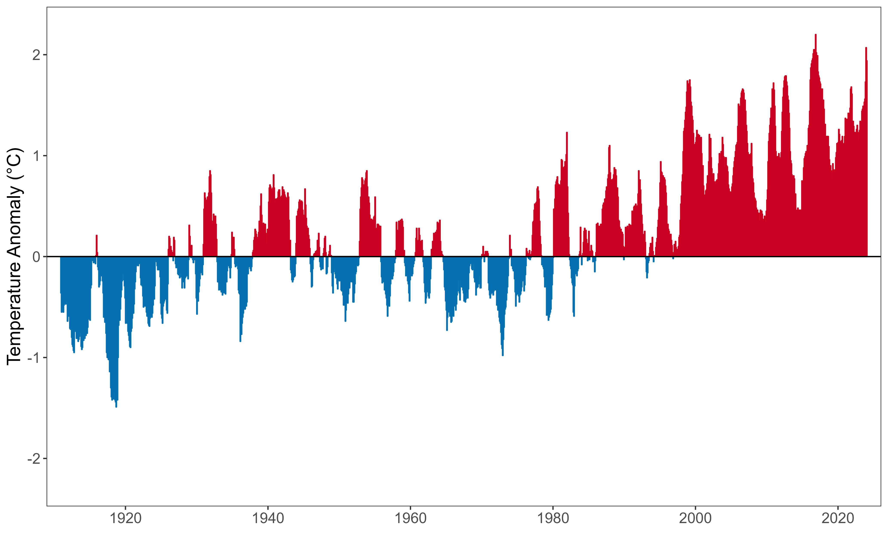
North America is getting warmer
(Relative to the 1910-2000 average)

Slide 6
What will western Canada look like in 2100?

Slide 7
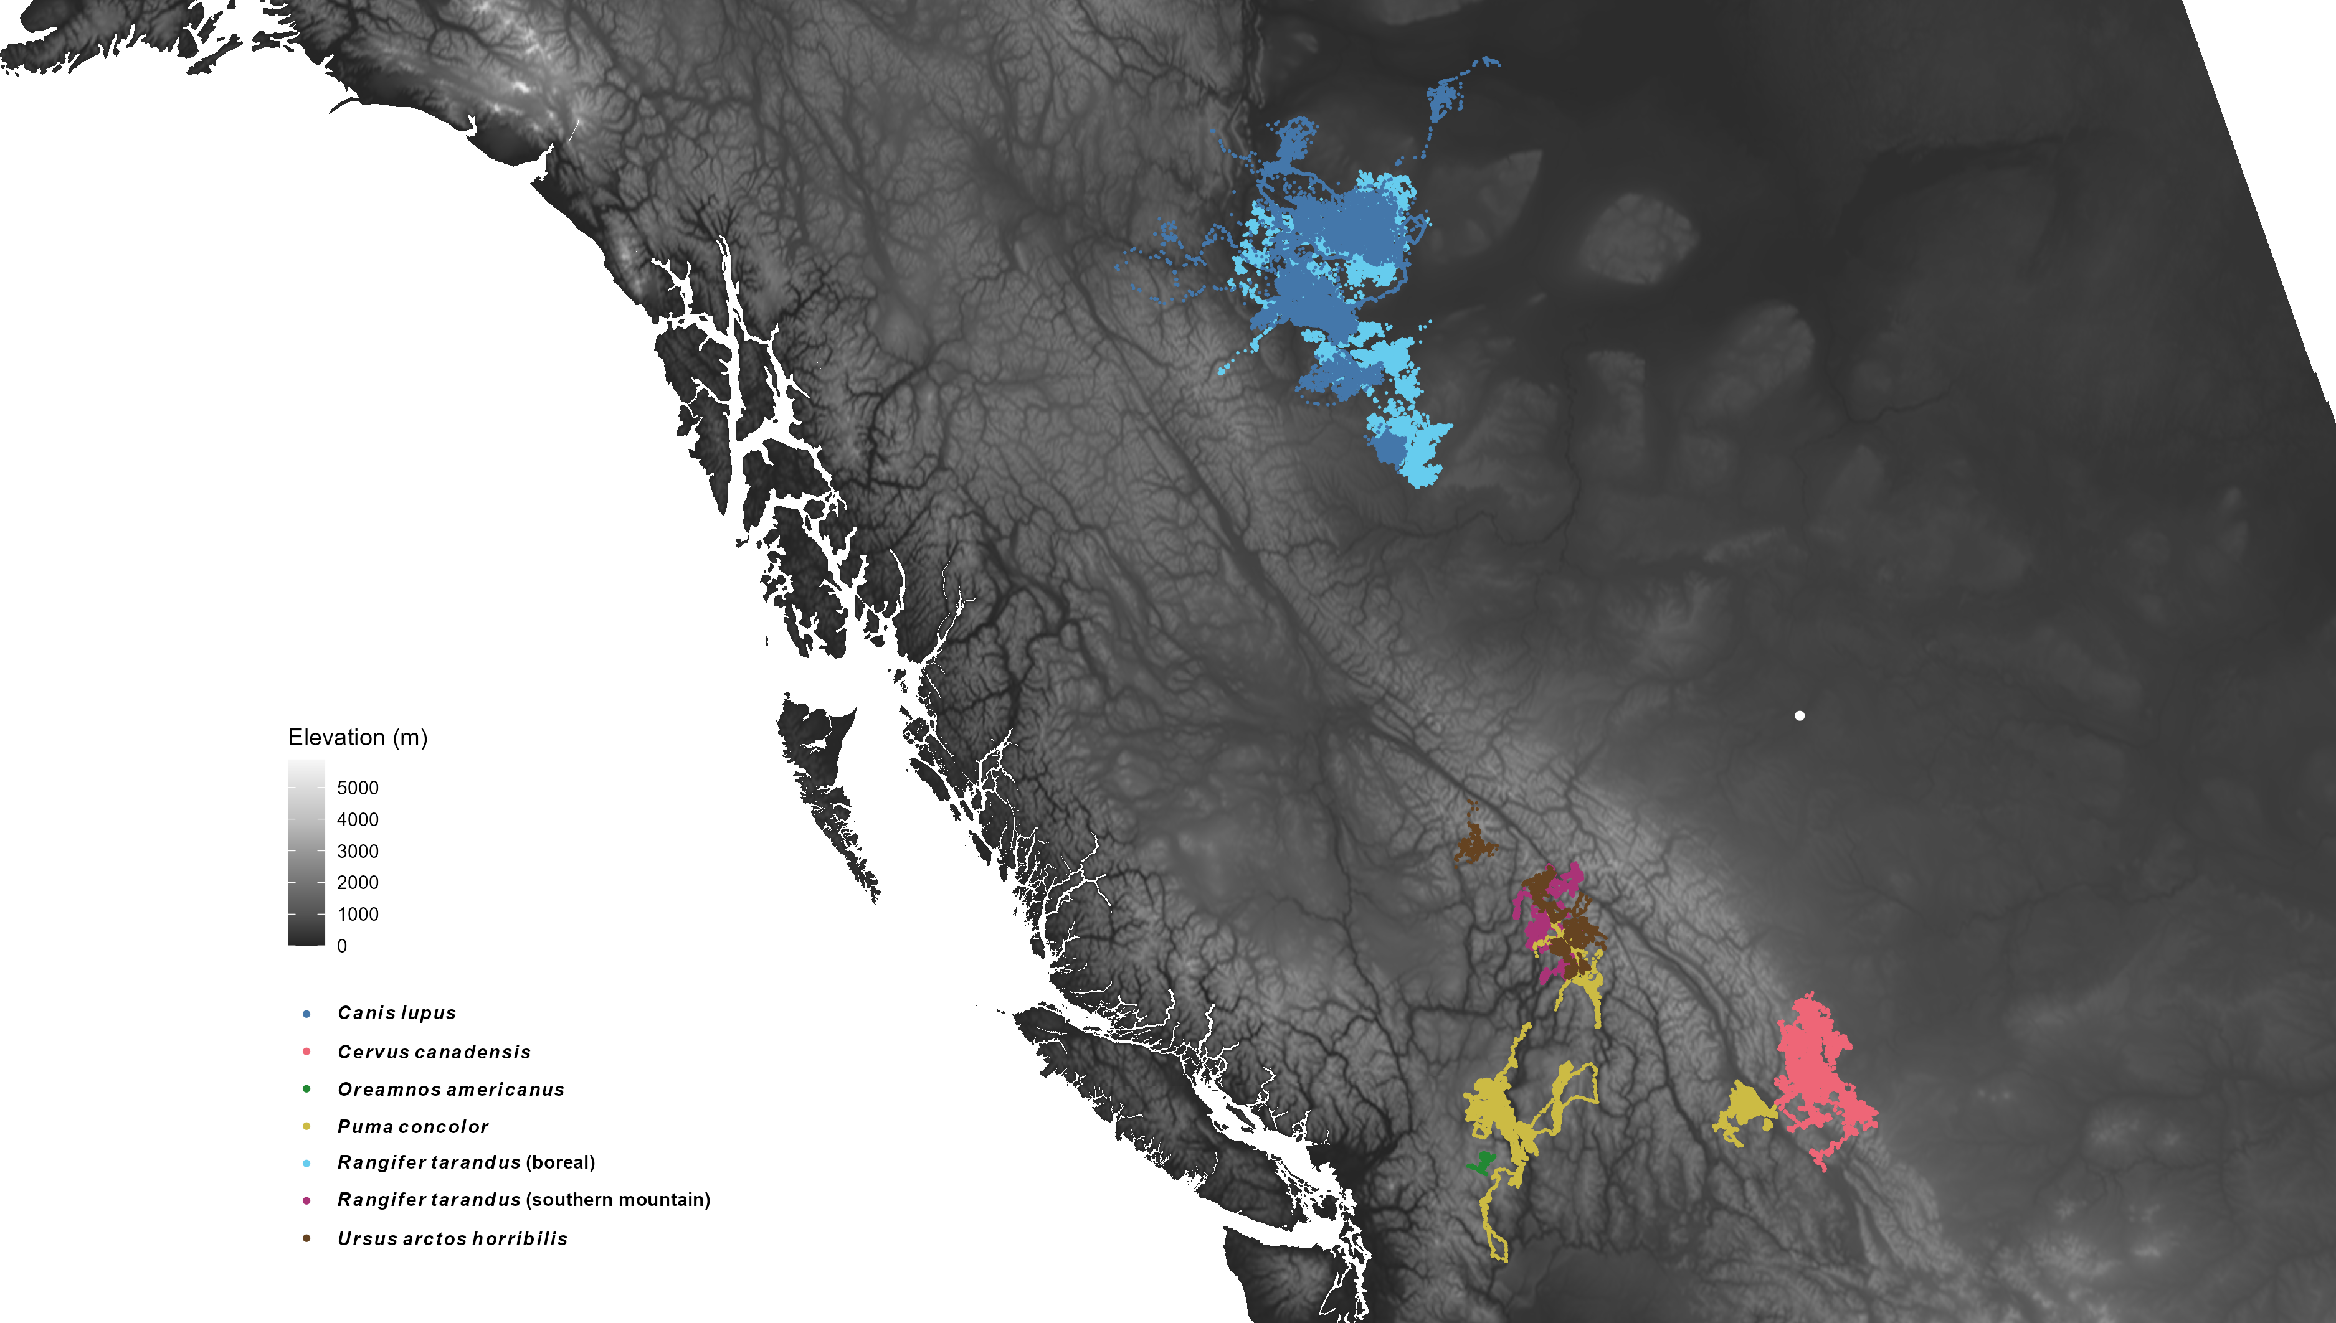


6 mammal species
2 caribou ecotypes
1.5 million GPS locations
Edmonton

Slide 8





There are many things that affect mammal behavior

Slide 9
Temperature and movement

Slide 10
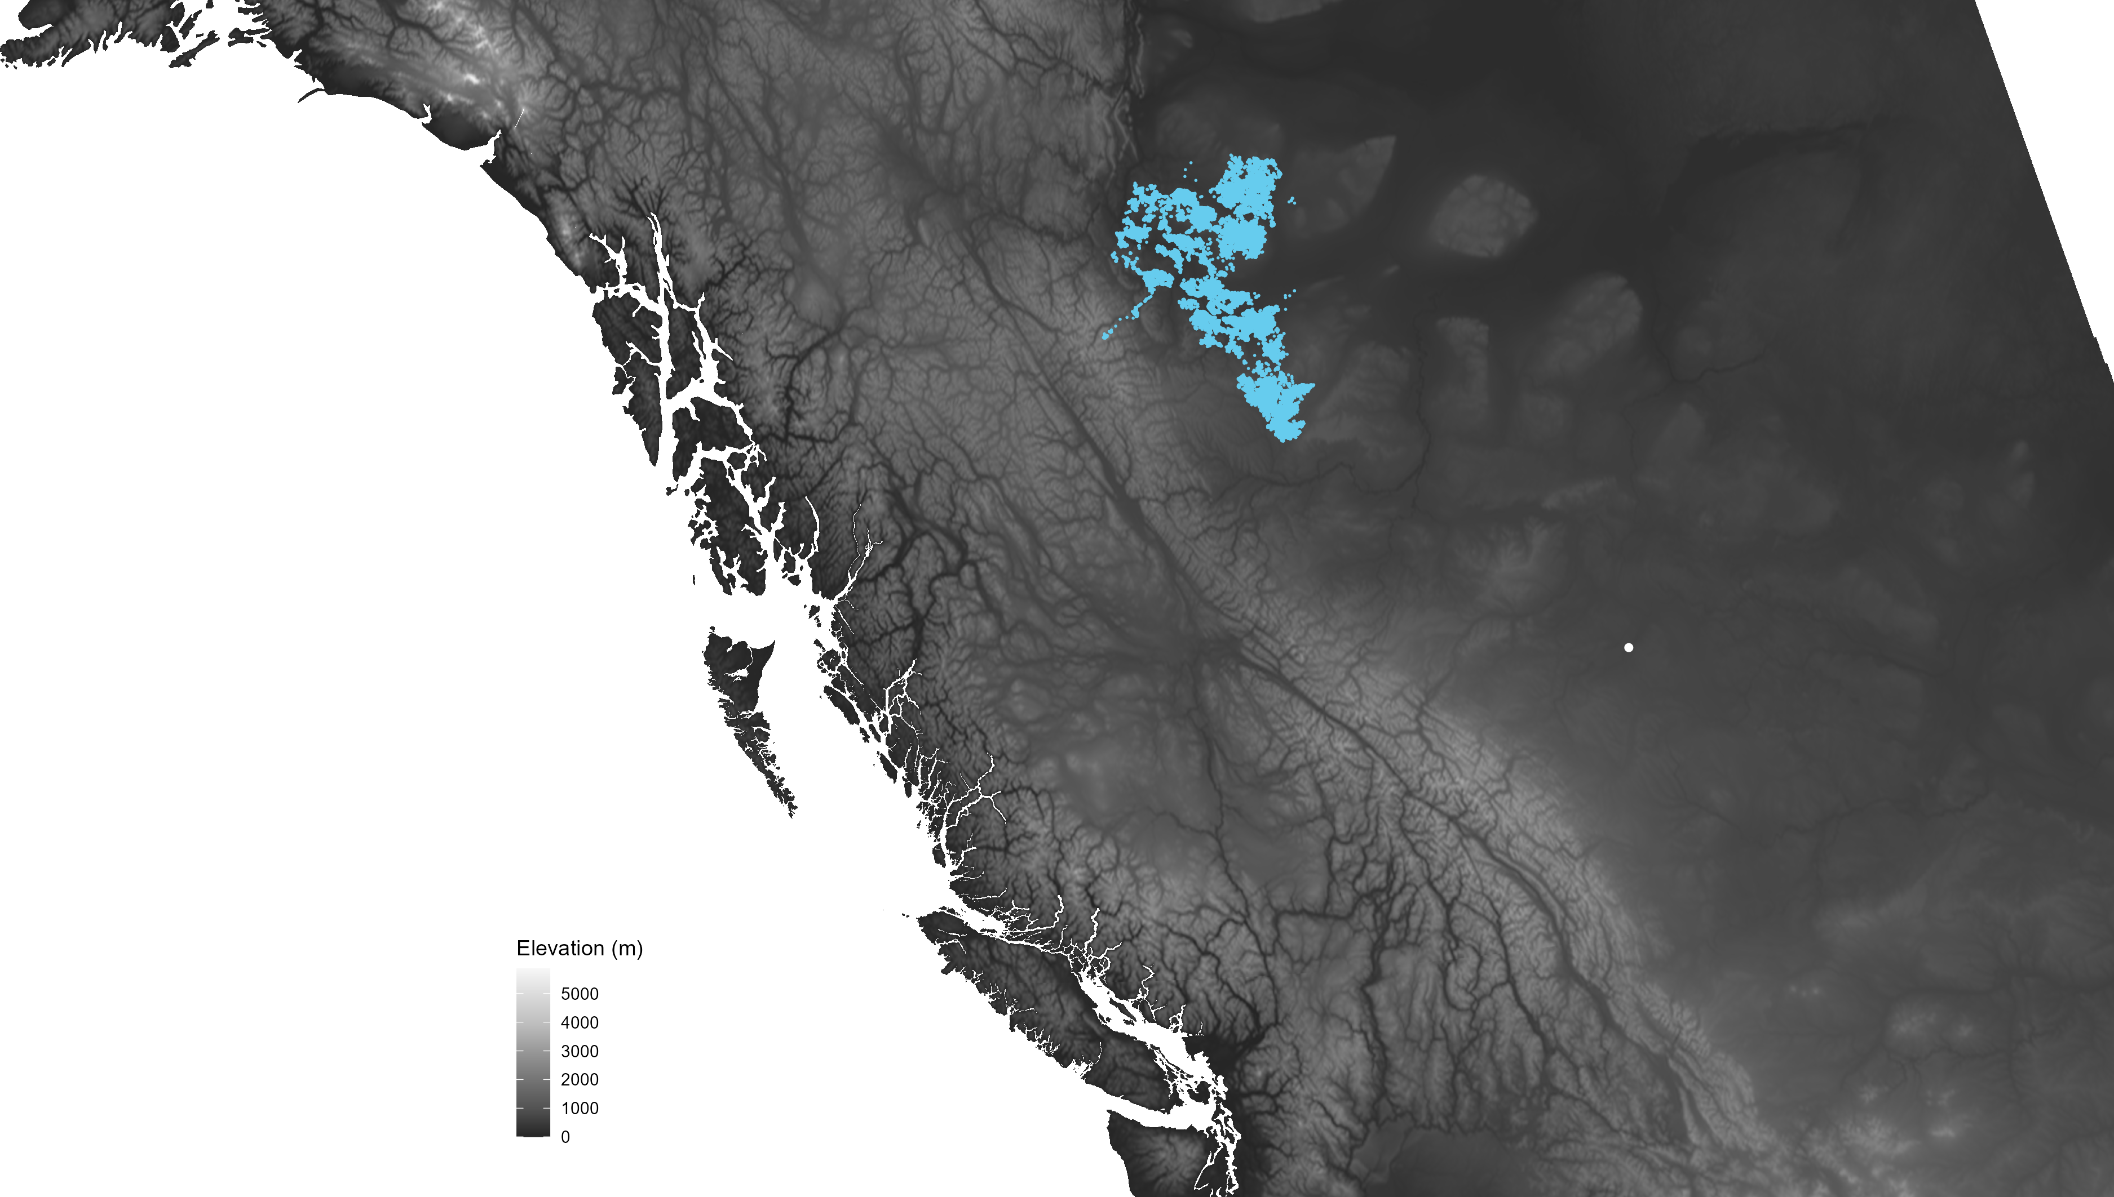
Edmonton

Slide 11
How does temperature affect how much boreal caribou move?

Slide 12
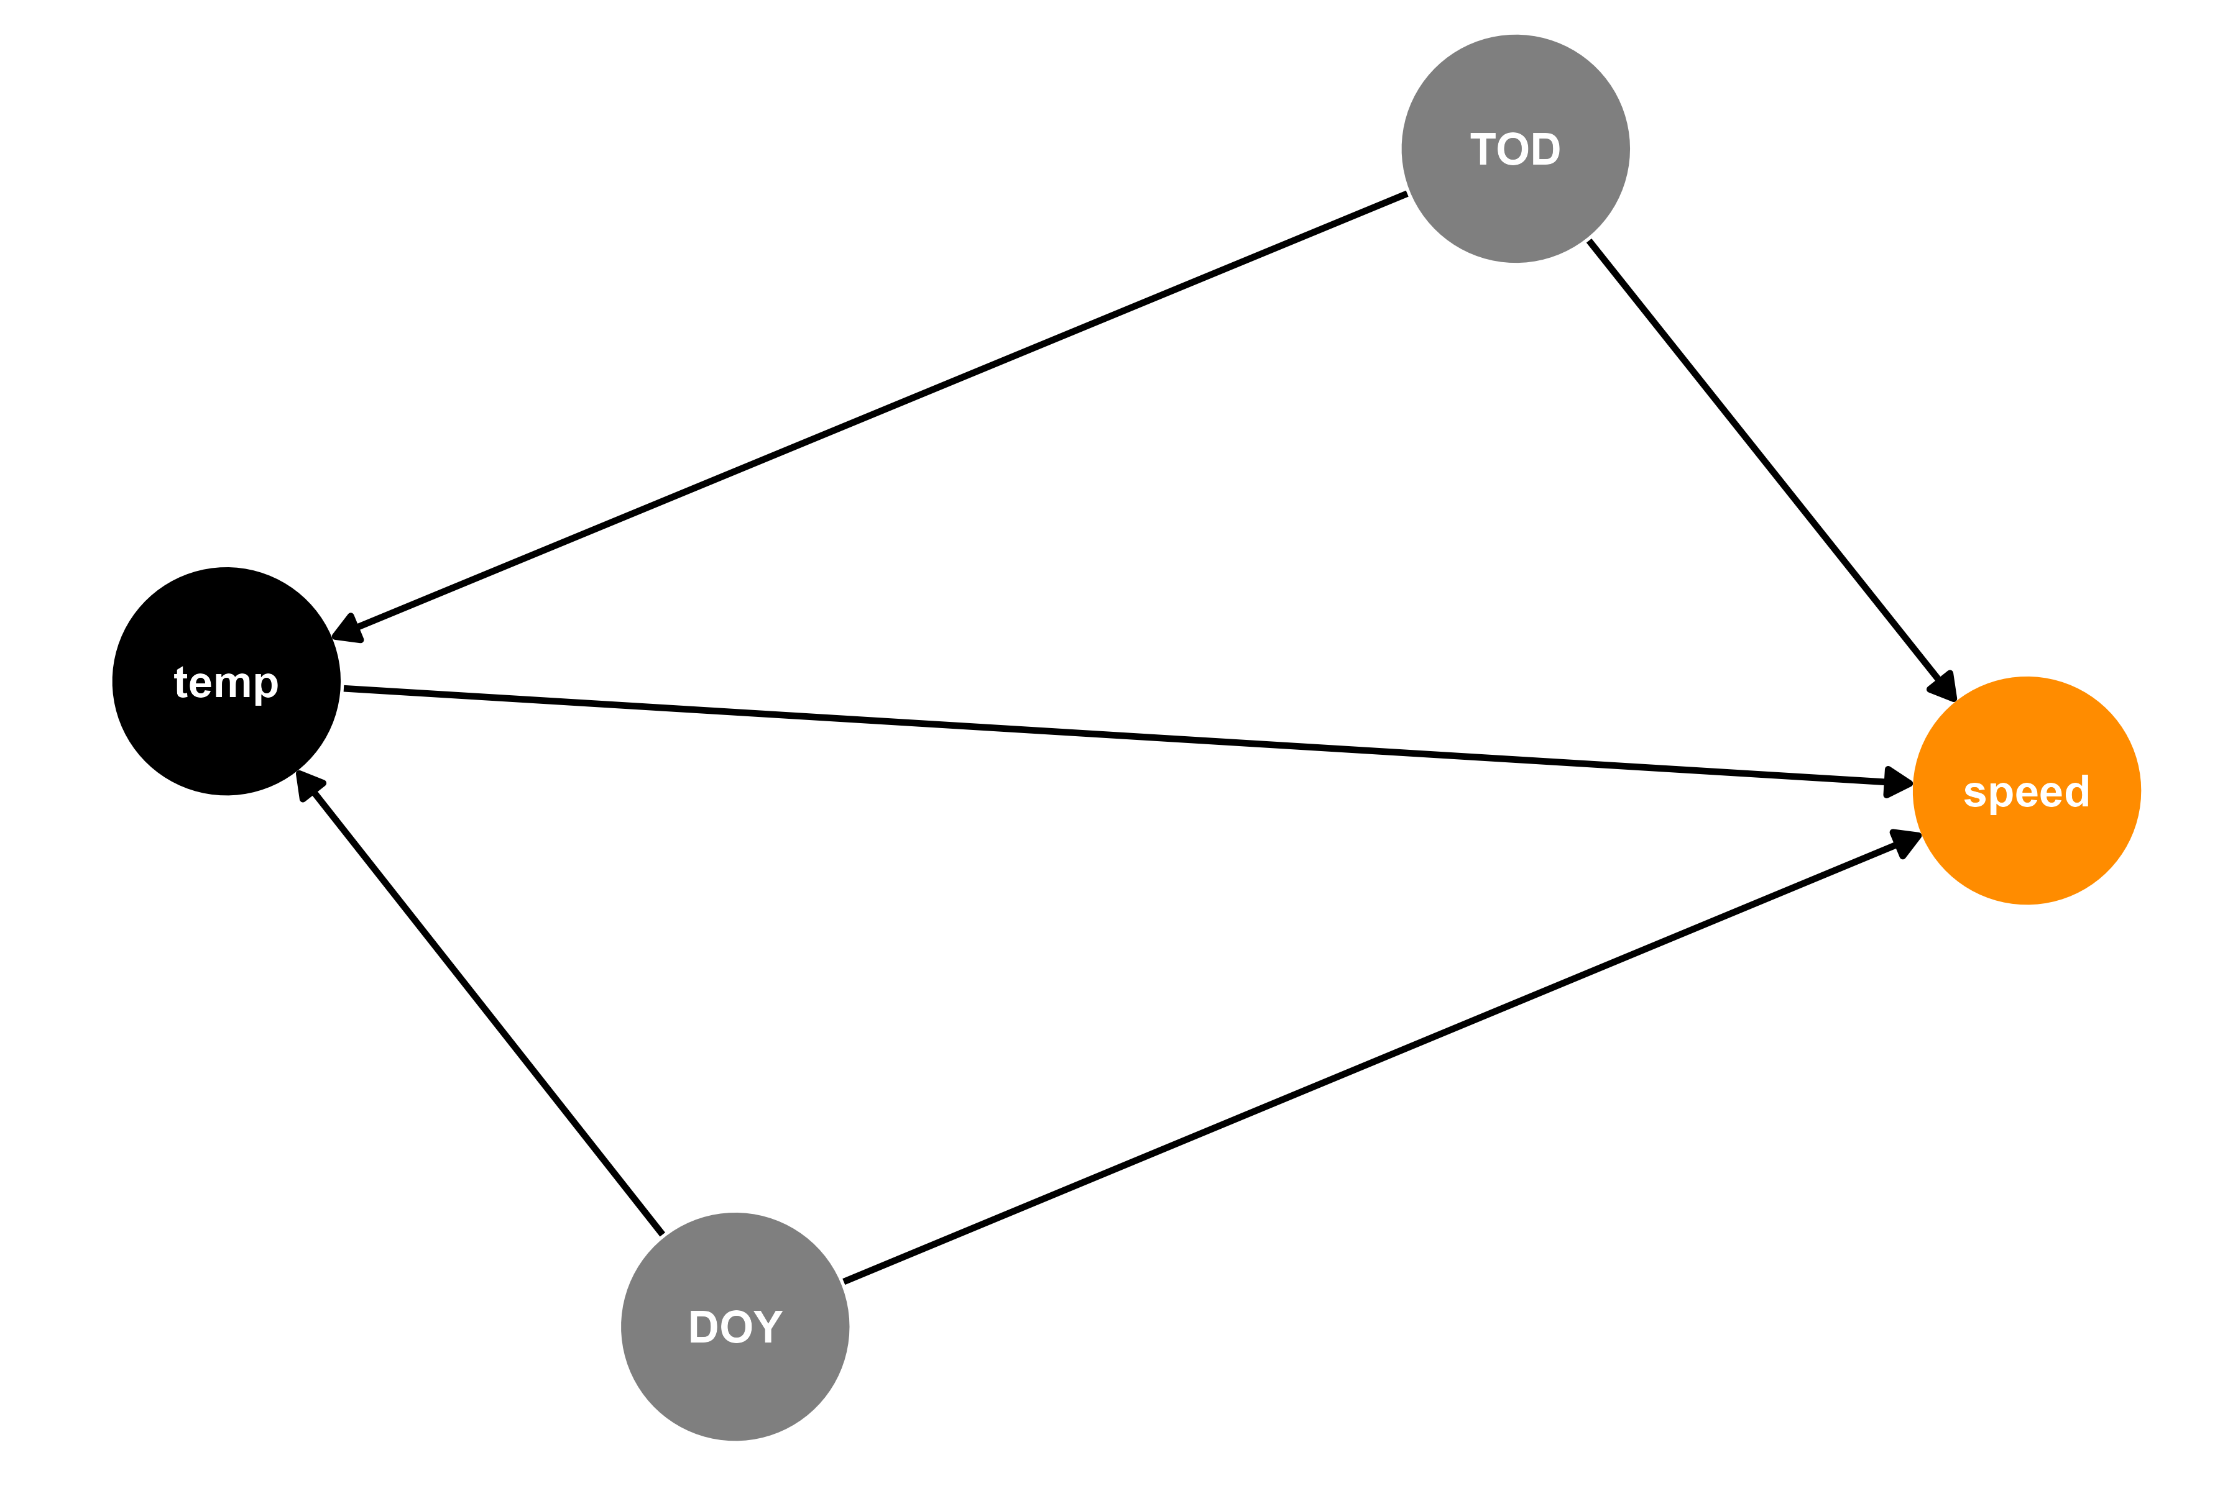


Modeling how much boreal caribou move
distance

Slide 13
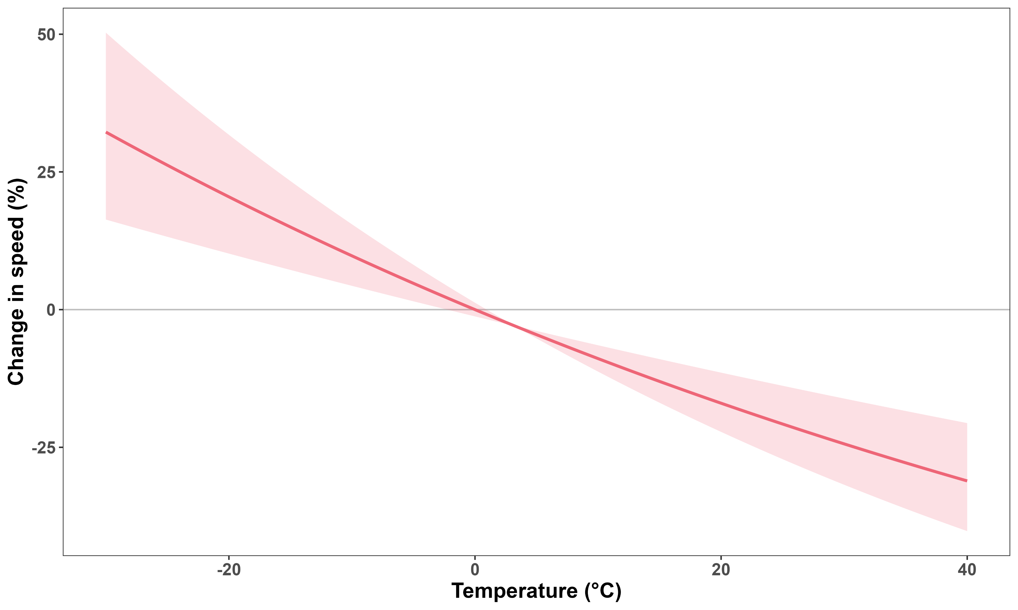
Speed depends strongly on temperature

Slide 14
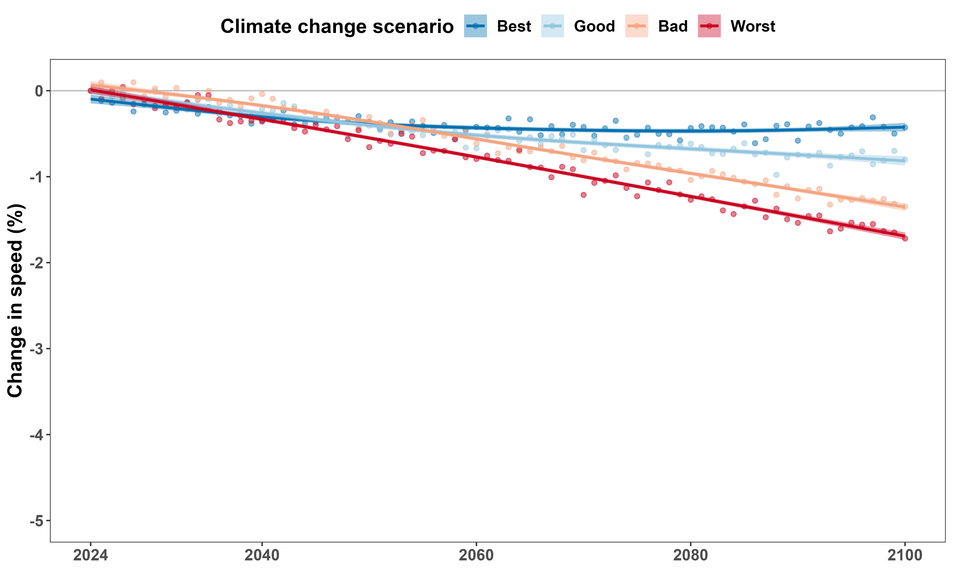
Cannot predict well using monthly average temperature

Slide 15
Temperature and habitat selection

Slide 16
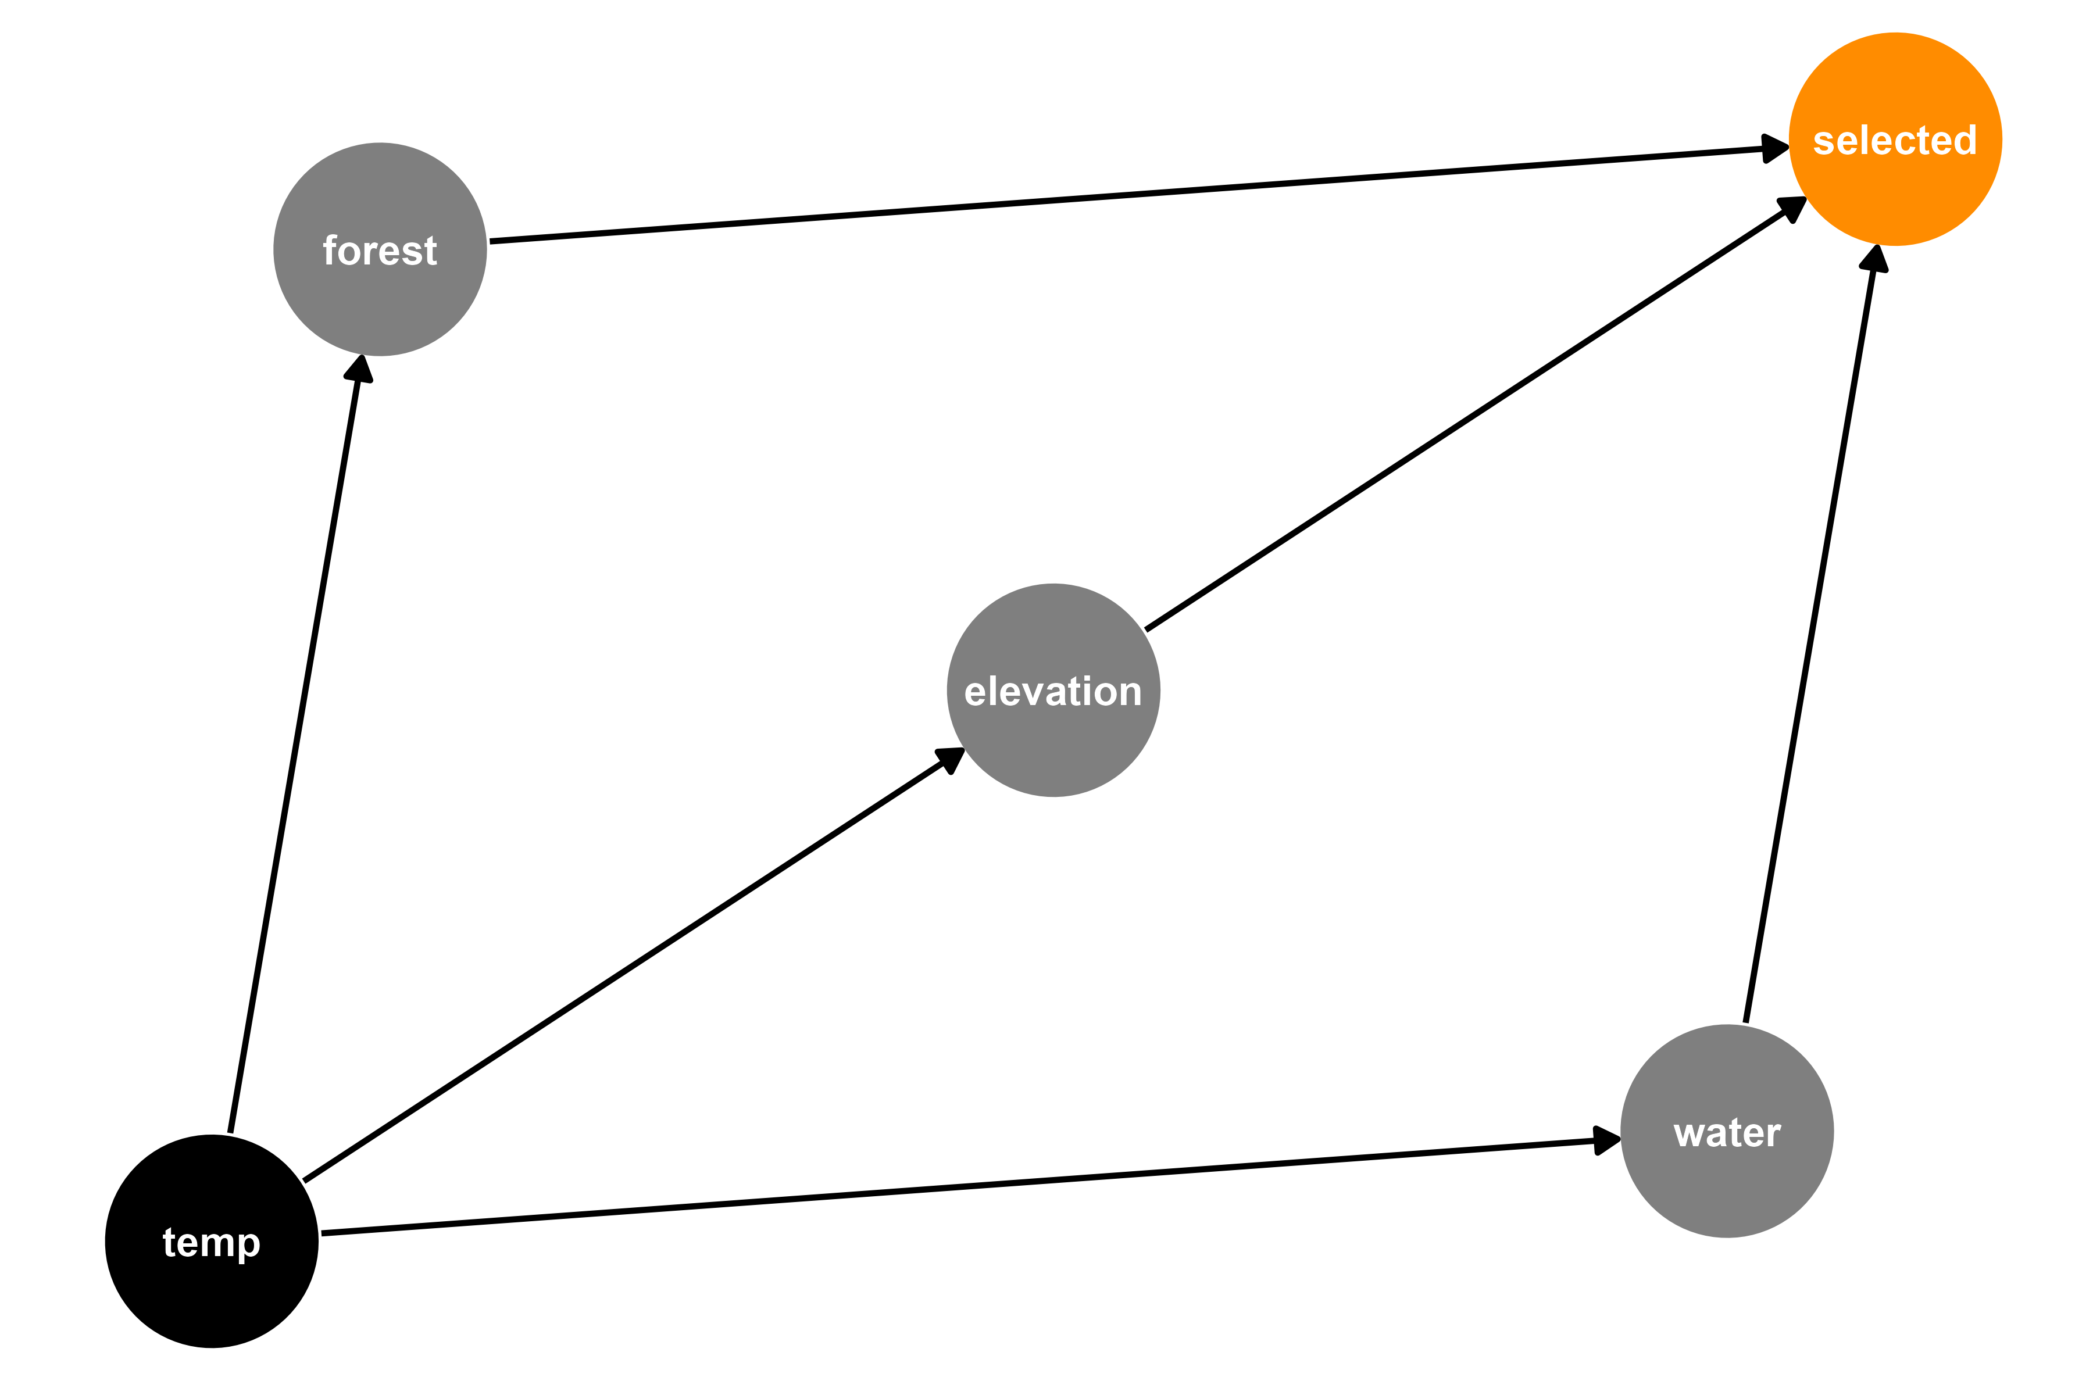



Modeling where boreal caribou move

Slide 17
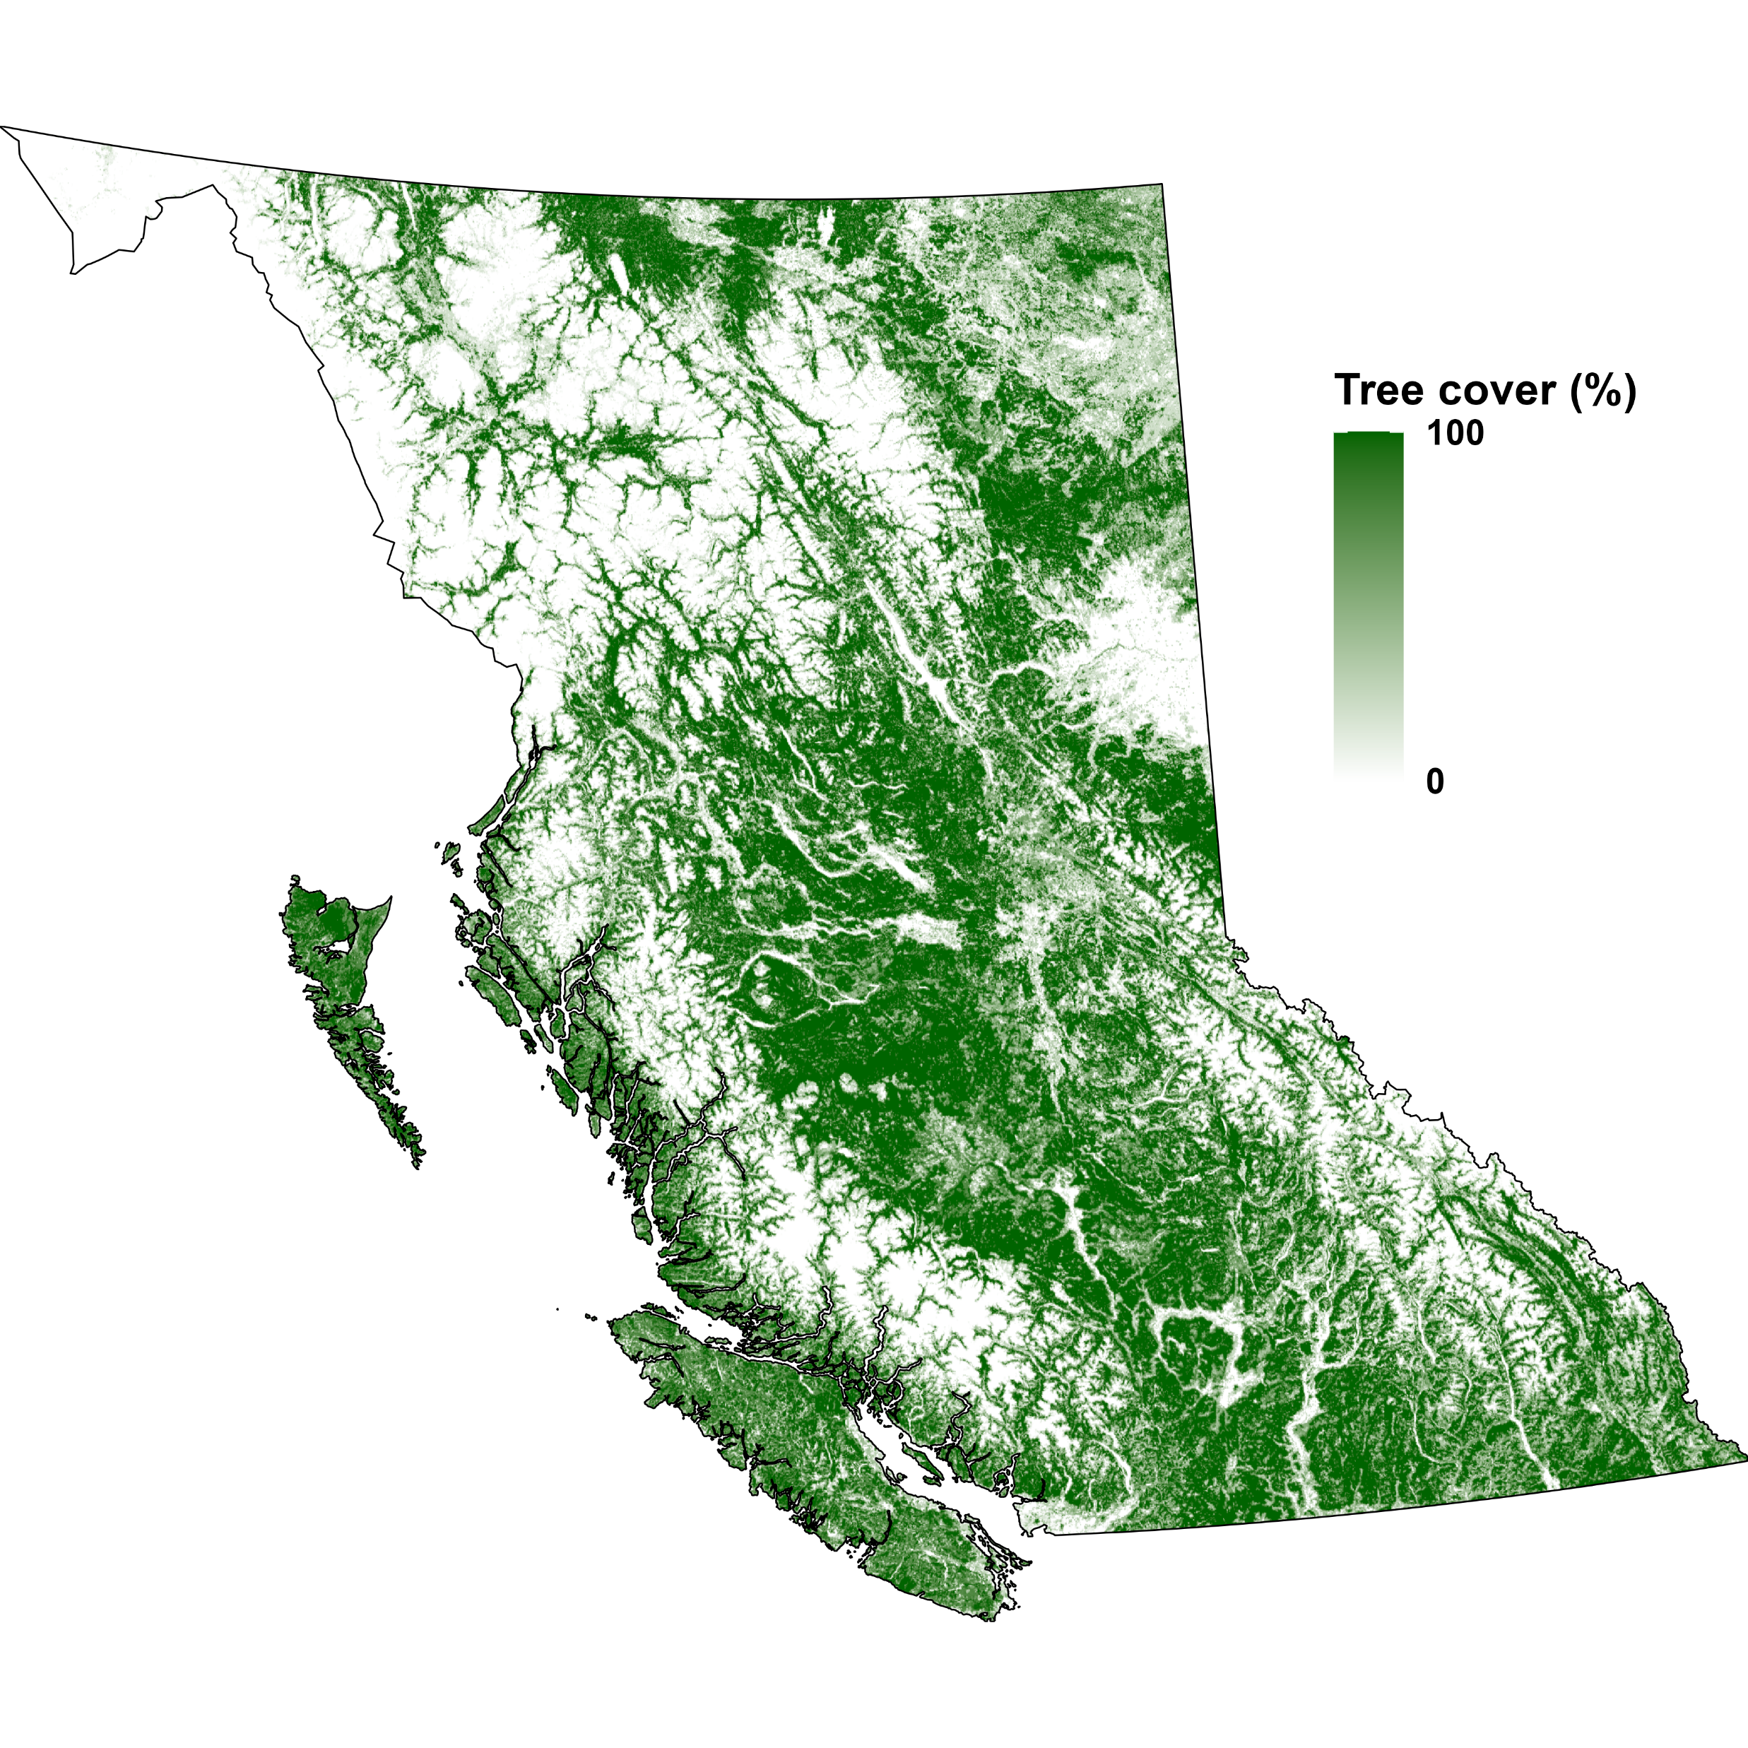
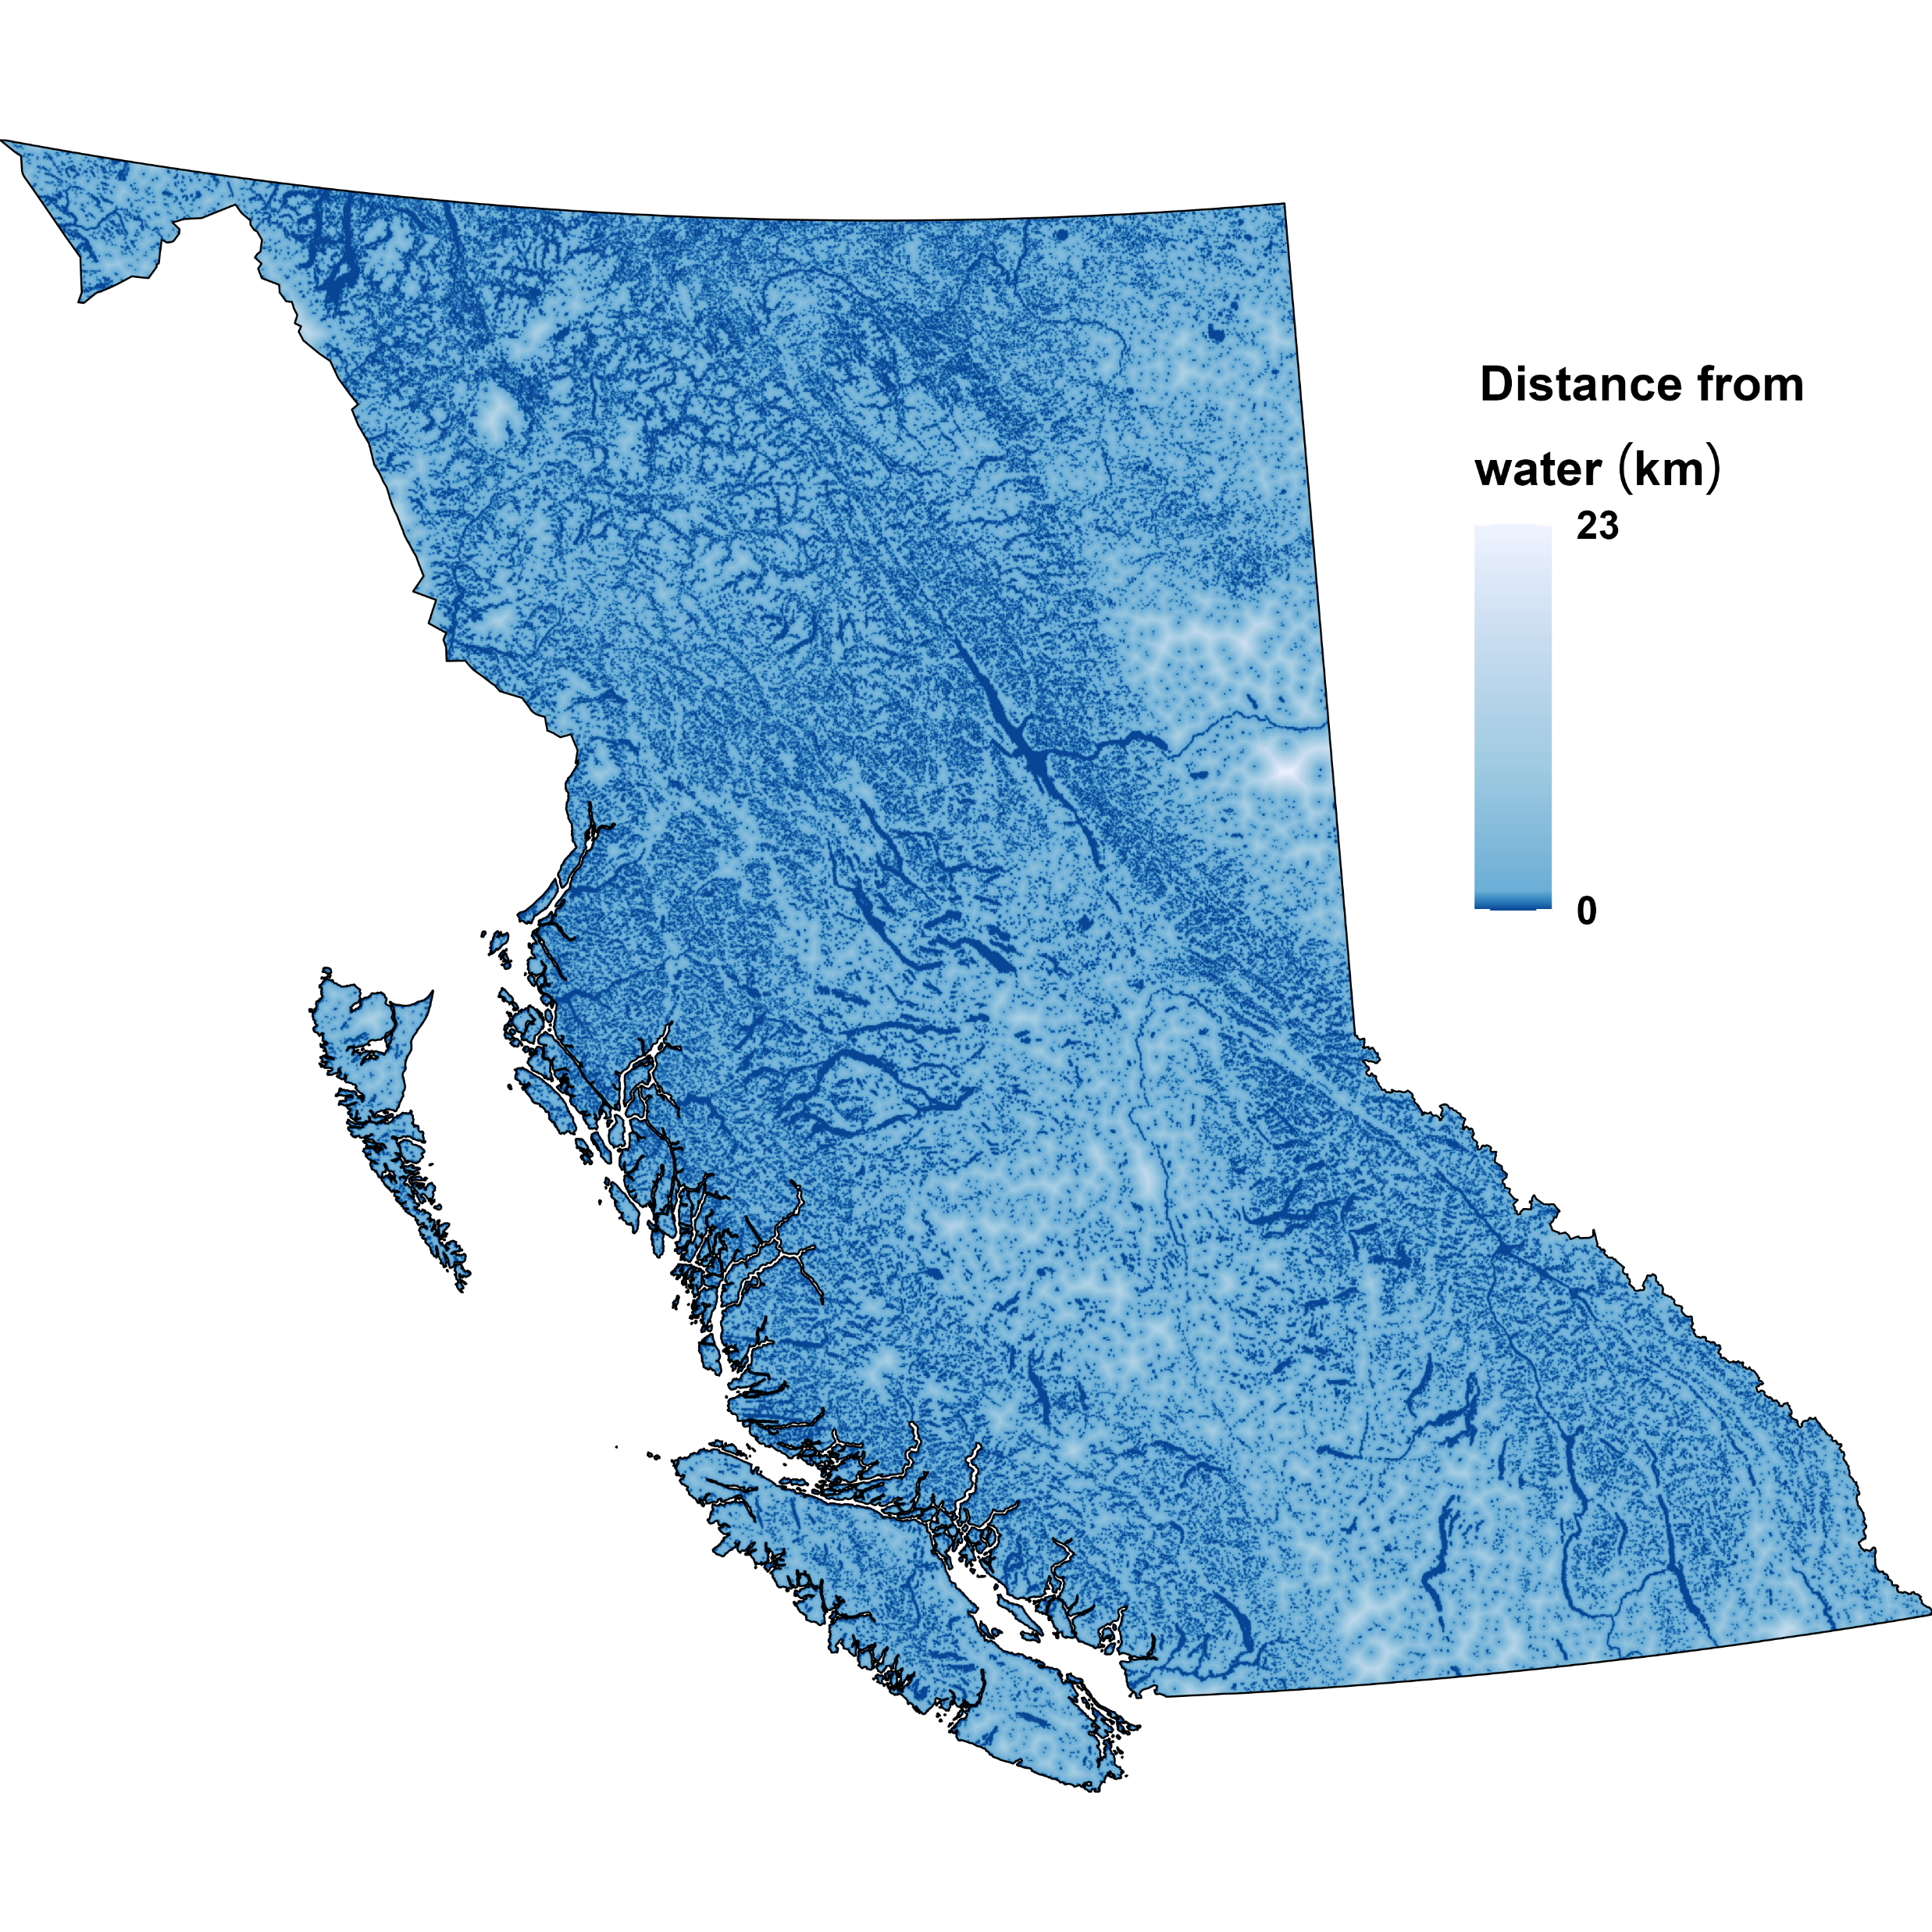
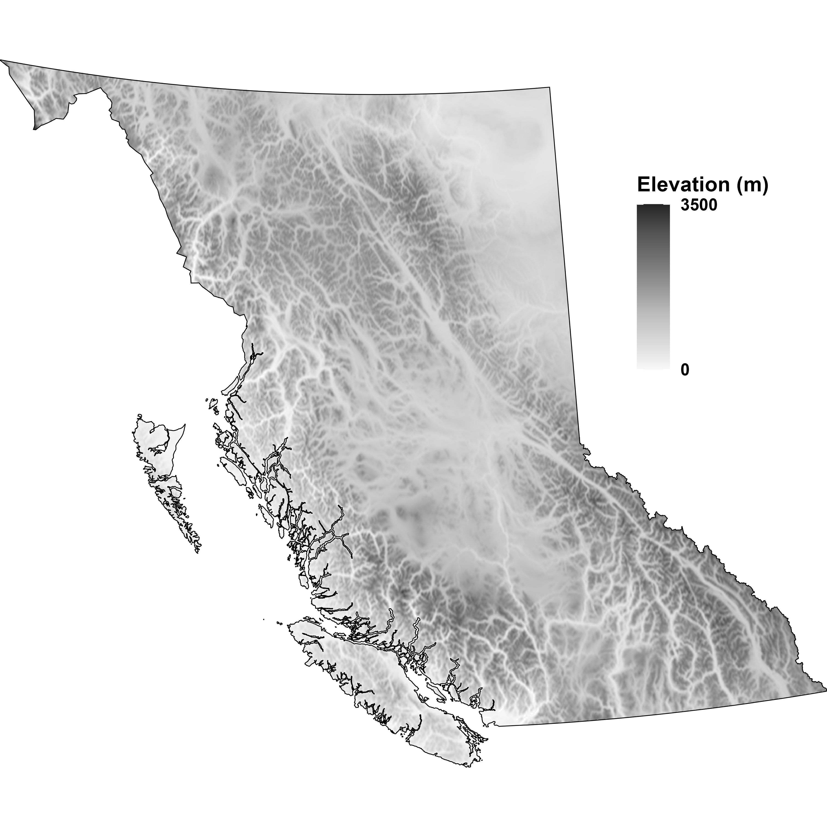

Slide 18
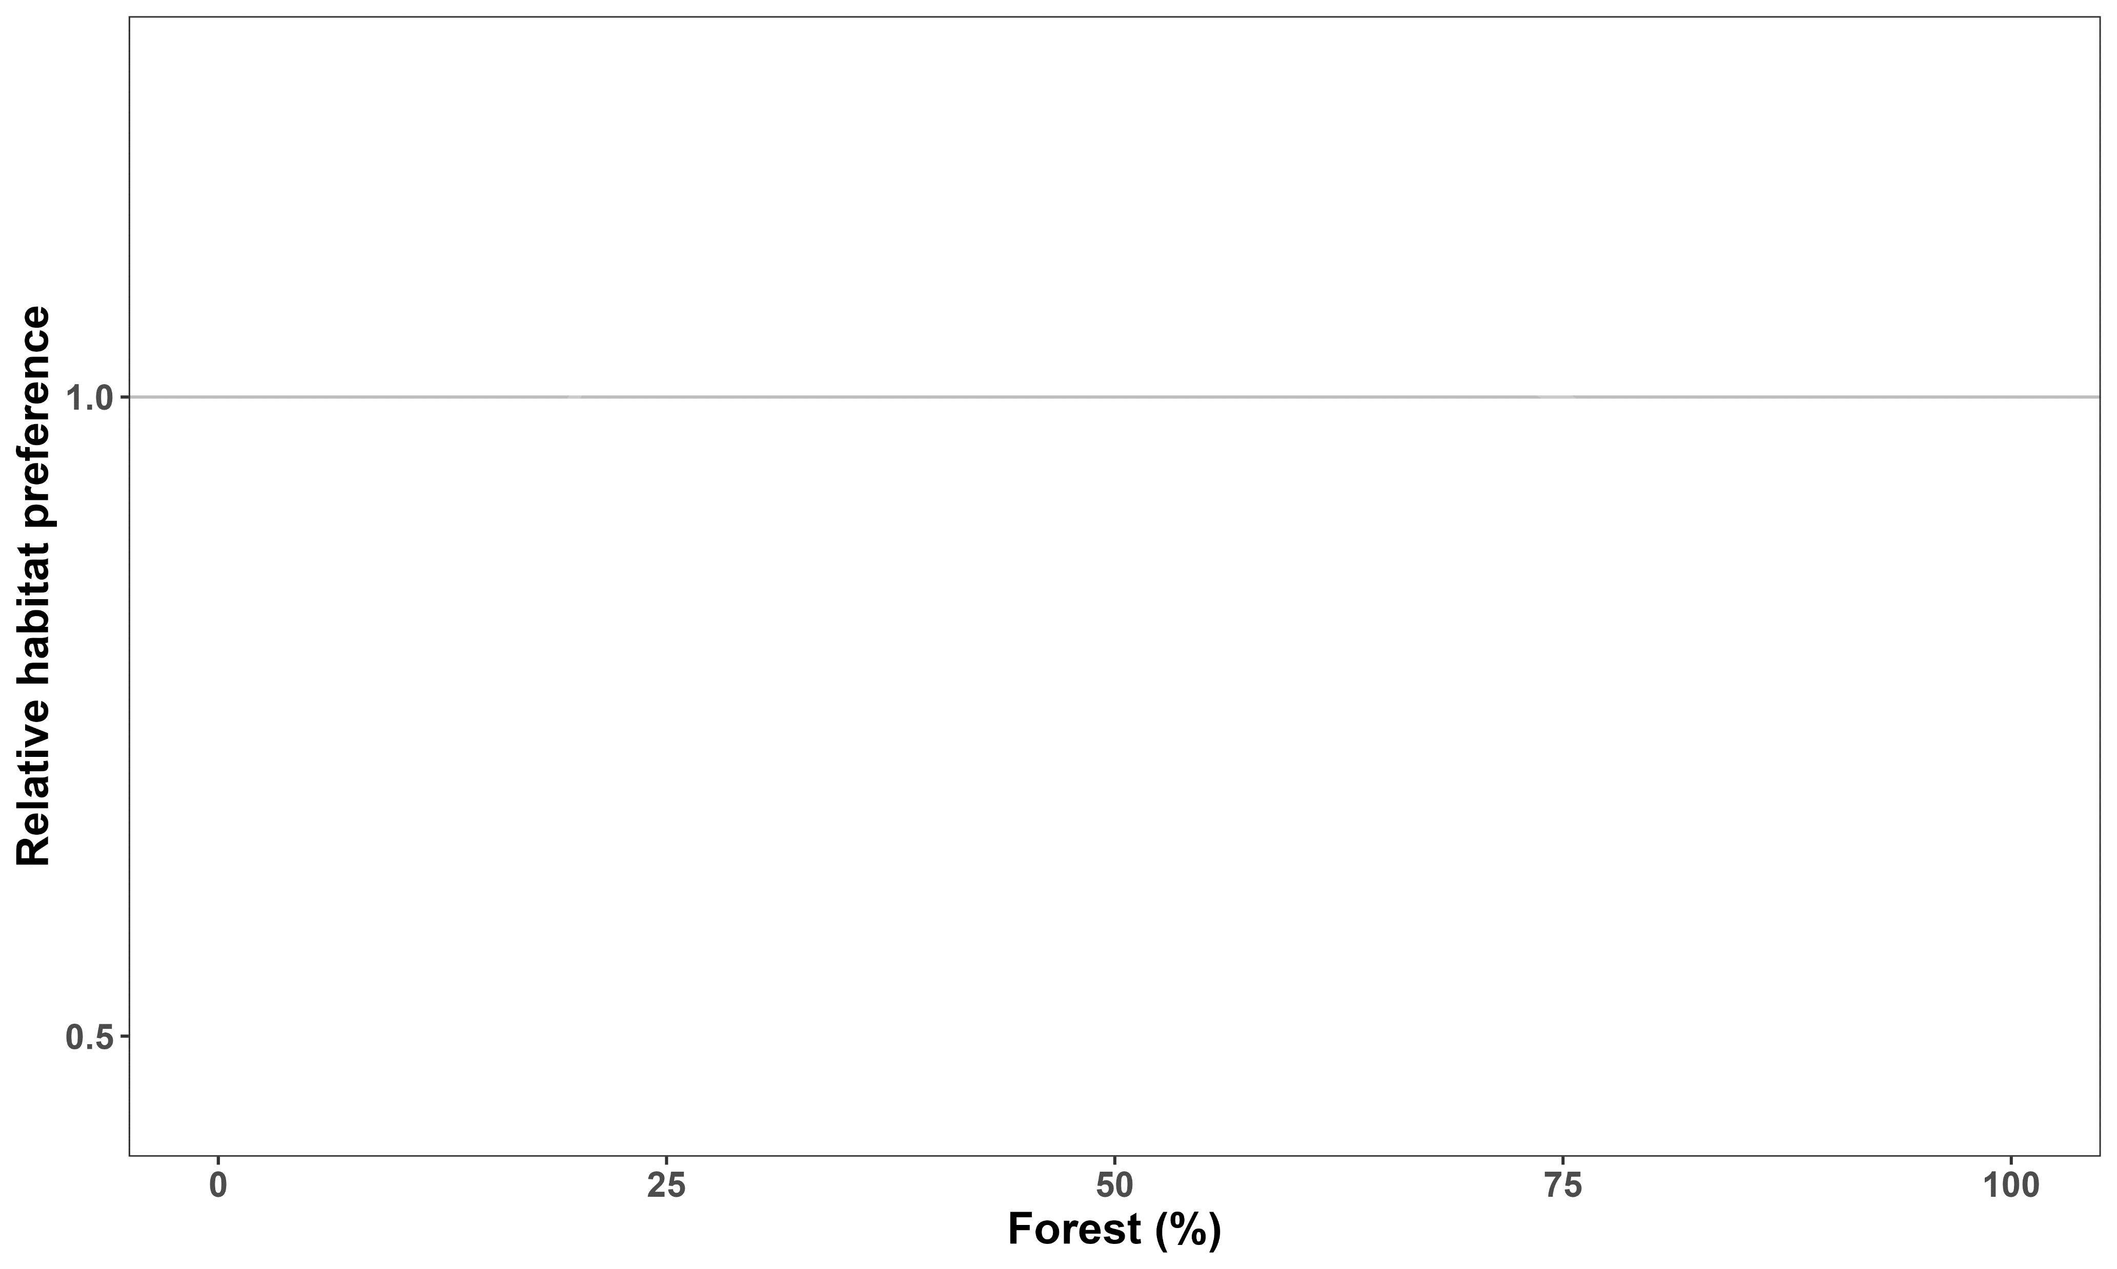

Boreal caribou prefer intermediate forest cover
Like
Dislike

Slide 19
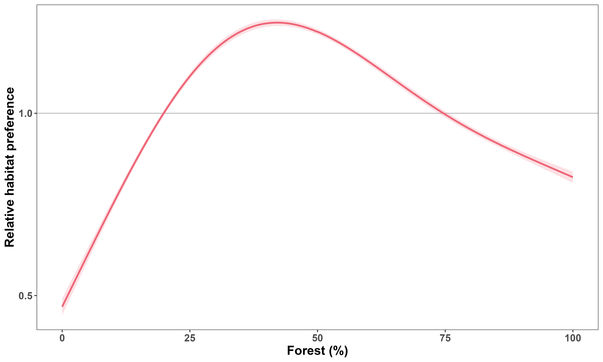
Boreal caribou prefer intermediate forest cover
Like
Dislike

Slide 20
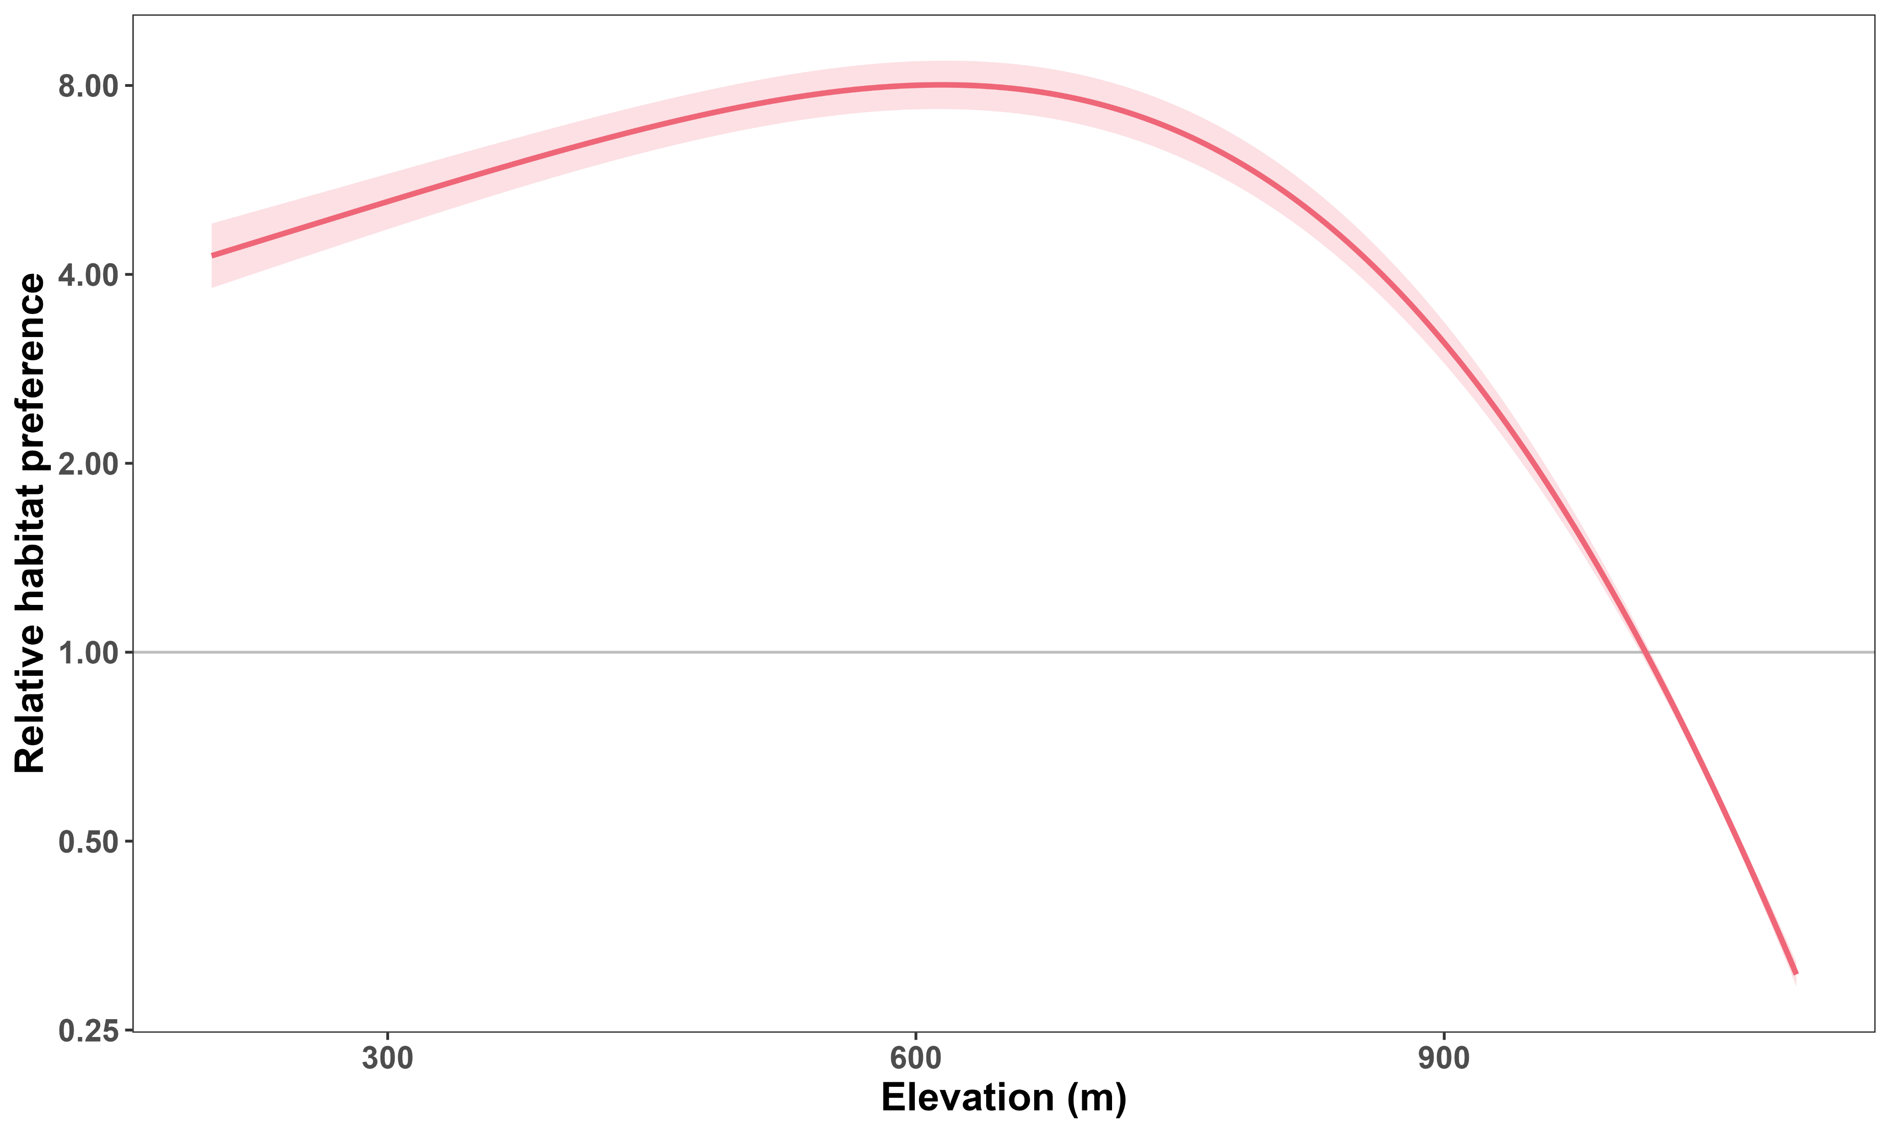

Boreal caribou prefer lower elevations
Like
Dislike

Slide 21
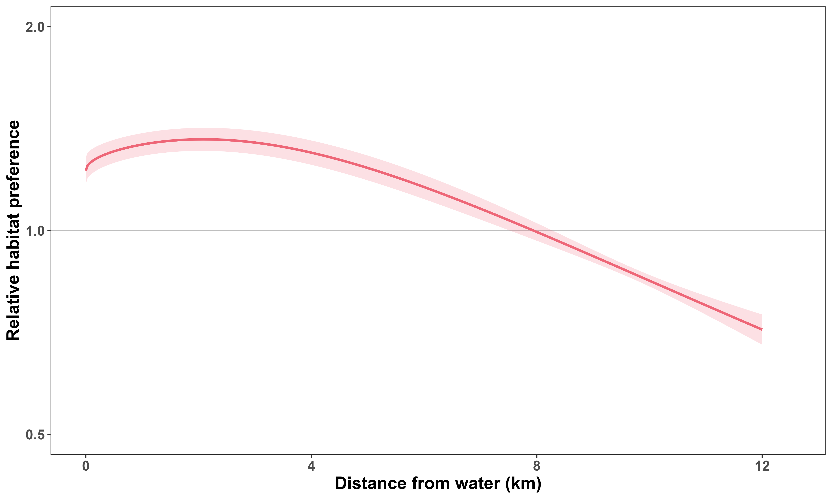

Boreal caribou prefer being near water
Like
Dislike

Slide 22


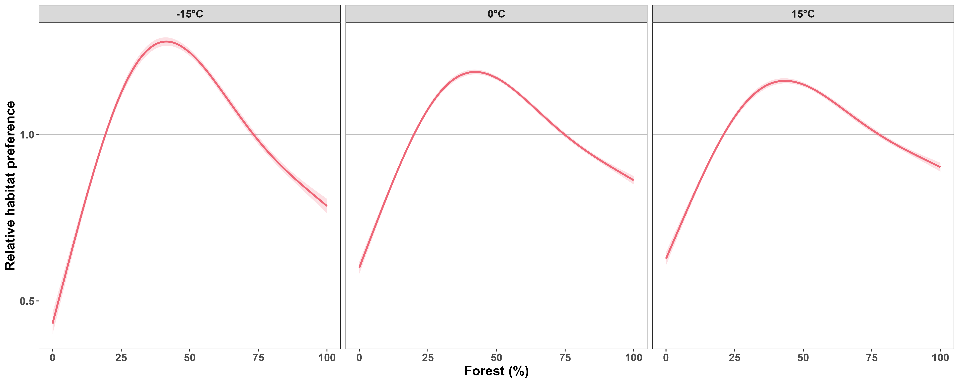
Forest preference is weaker at warmer temperatures

Slide 23
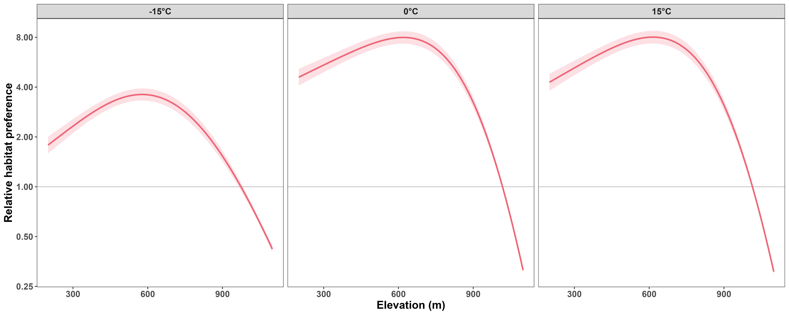
Boreal caribou avoid high elevation more at warmer temperatures

Slide 24
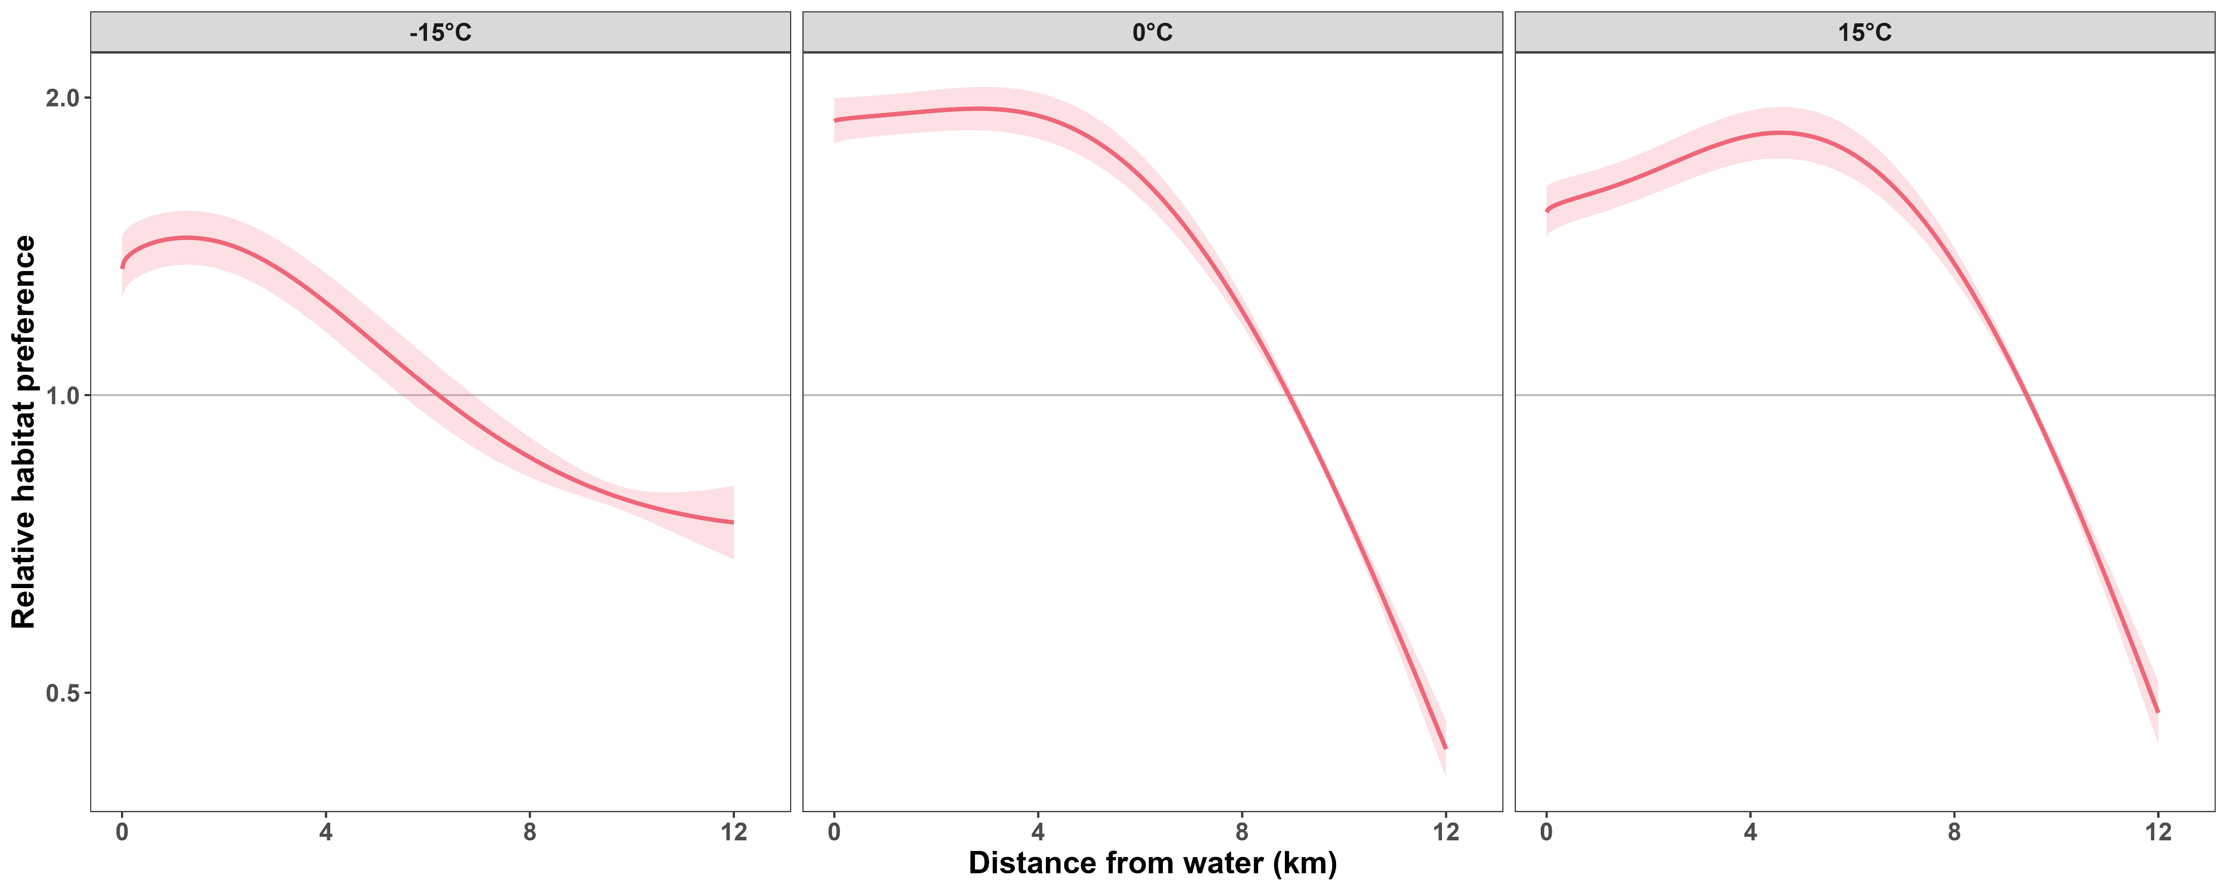
Boreal caribou stay closer to water at warmer temperatures

Slide 25
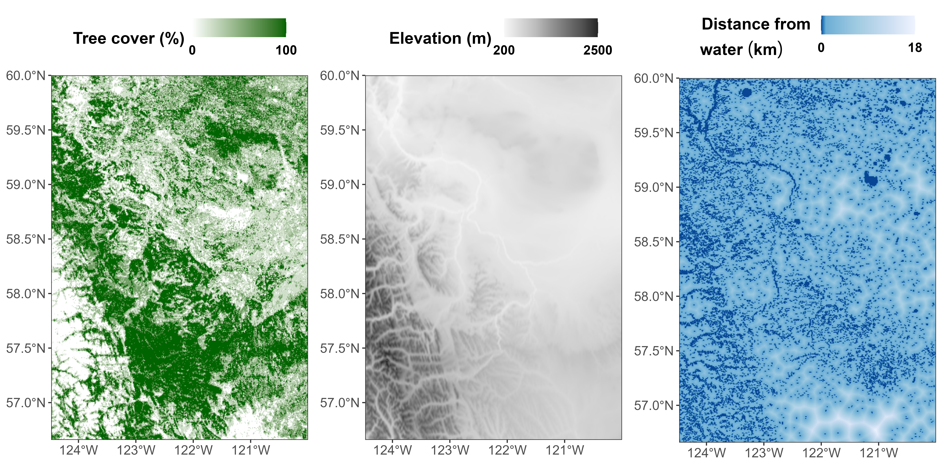
Predicting within the current range

Slide 26
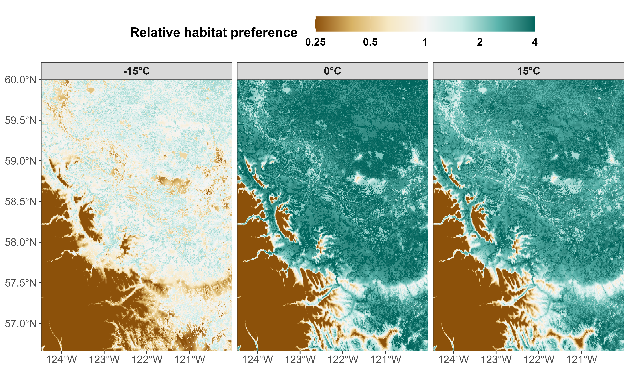
Habitat preference depends strongly on temperature

Slide 27
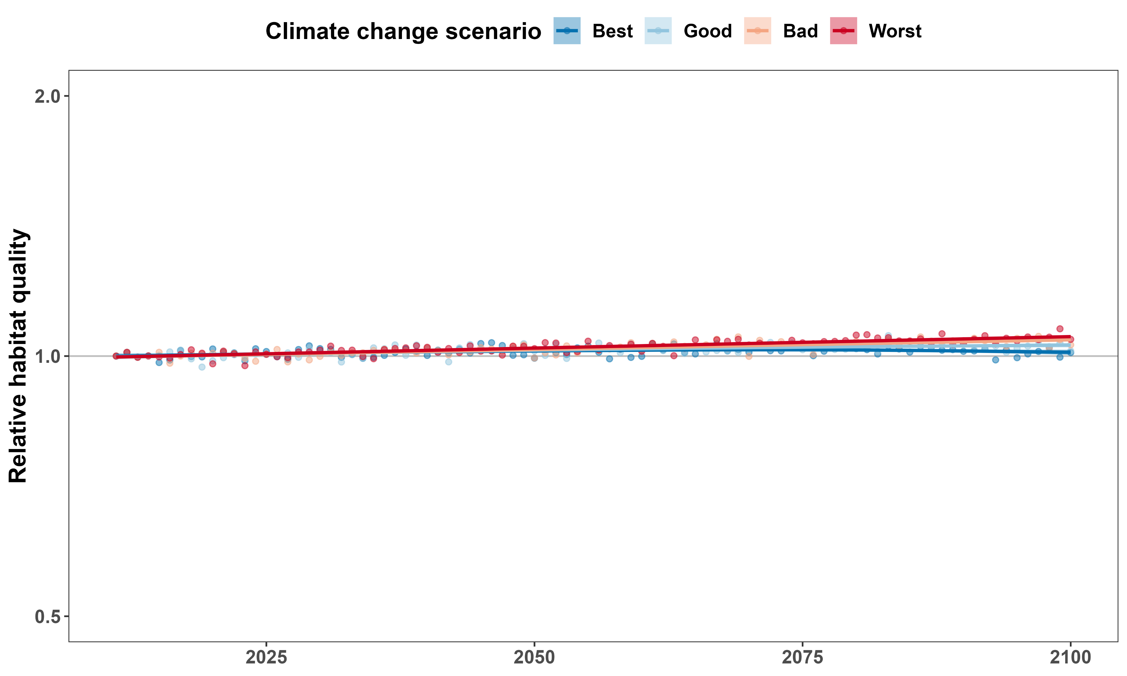
Cannot predict well using monthly average temperature
Like
Dislike

Slide 28
6 mammal species
2 caribou ecotypes
1.5 million GPS locations
Edmonton

Slide 29
Add results for other species

Slide 30



Consequences for conservation
Predicting the future using historical data is hard:
Mammals’ responses to temperature are nonlinear
Little data at extreme temperatures
No good simulations of daily/hourly weather
No good predictions of what habitats will look like
Protect areas proactively
May need to change current protected areas
GitHub Repo

Slide 31






Acknowledgements

Slide 32
DUPLICATE CONCLUSION SLIDE
GitHub Repo

Slide 33
References and credits
1. http://webdocs.edmonton.ca/InfraPlan/demographic/Edmonton%20Population%20Historical.pdf
Cougar phylopic: CC BY-NC 3.0: Cristian Osorio & Paula Carrera, Proyecto Carnivoros Australes
Mountain goat phylopic: CC-BY-SA 3.0: Sarah E. Haworth
R code can be found at https://github.com/QuantitativeEcologyLab/bc-mammals-temperature

